Slide 1
Authorities

Slide 2
The word authority is derived from the latin word
invention, advice, opinion, influence, or command.
In English, the word authority can be used to mean power given by the state (in the form of Members of Parliament, Judges, Police Officers, etc.)

Slide 3
Public Relation
Public relations (PR) is the practice of managing the flow of information between an organisation and its publics.
Public could include shareholders, government, consumers, employees and the media.
It is the act of getting along with people we constantly come in touch with.

Slide 4
PROs ensures internal cohesion in the company by maintaining a clear communications network between the management and employees.
Its first objective is to improve channels of communication and to establish new ways of setting up a two-way flow of information and understanding.

Slide 5
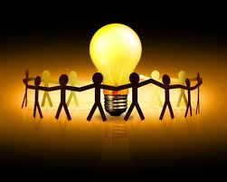

Slide 6
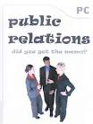

Slide 7

Planning
the psychological process of thinking about the activities required to create a desired goal on some scale.
Planning is a process for accomplishing purposes. It is a blue print of business growth and a road map of development.

Slide 8
Importance of the planning process
A plan can play a vital role in helping to avoid mistakes
Planning helps in forecasting the future, makes the future visible to some extent.
It bridges between where we are and where we want to go.
Planning is looking ahead.

Slide 9
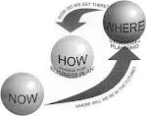

Slide 10
Monitoring & Evaluation
Monitoring is the systematic collection and analysis of information as a project progresses.
It helps to keep the work on track, and can let management know when things are going wrong

Slide 11
Evaluation is the comparison of actual project impacts against the agreed strategic plans. It
looks at what you set out to do, at what you have accomplished, and how you accomplished it.
what you are doing and how you are doing it, by focusing on:
  Efficiency
  Effectiveness
  Impact

