Slide 1
methods

Slide 2
Public Interest Mobilization
publics are groups of individuals
a community as a whole
Interest ‘to be concerned with or engaged in’
Mobilization ‘the assembling or preparation of something in response to a need’.

Slide 3
Thus……….
Public Interest Mobilization is nothing but.,
- congregation on the Information of the interest and need of the community.
- Identification of the interest of the community
- it’s a method of accumulation of the need of the community.

Slide 4
Public Interest Litigation
Public Interest Litigation (PIL) means Litigation for the protection of the Public Interest .
Litigation - legal action,

Slide 5
definition
According to Black's Law Dictionary- "Public Interest Litigation means a legal action initiated in a court of law for the enforcement of public interest or general interest in which the public or class of the community have pecuniary interest or some interest by which their legal rights or liabilities are affected."

Slide 6
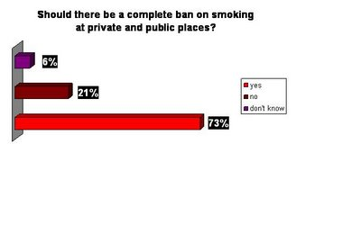

Slide 7
Protests
A protest is an expression of objection, by words or by actions, to particular events, policies or situations.
Protests can take many different forms, from individual statements to mass demonstrations.
Protesters may organize a protest as a way of publicly making their opinions heard in an attempt to influence public opinion or government policy, or
they may undertake direct action in an attempt to directly enact desired changes themselves.

Slide 8
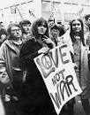
Pictures

Slide 9
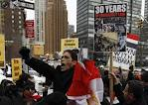

Slide 10


Slide 11
demonstrations
A demonstration or street protest is action by a mass group or collection of groups of people in favor of a political or other cause; it normally consists of walking in a mass march formation and either beginning with or meeting at a designated endpoint, or rally, to hear speakers.

Slide 12
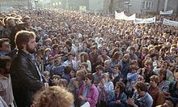

Slide 13
