Slide 1
SOCIAL ENTREPRENEURSHIP & ENTERPRISE
Submitted by
Reshma Jaleel
20MSW035
II MSW

Slide 2


Slide 3
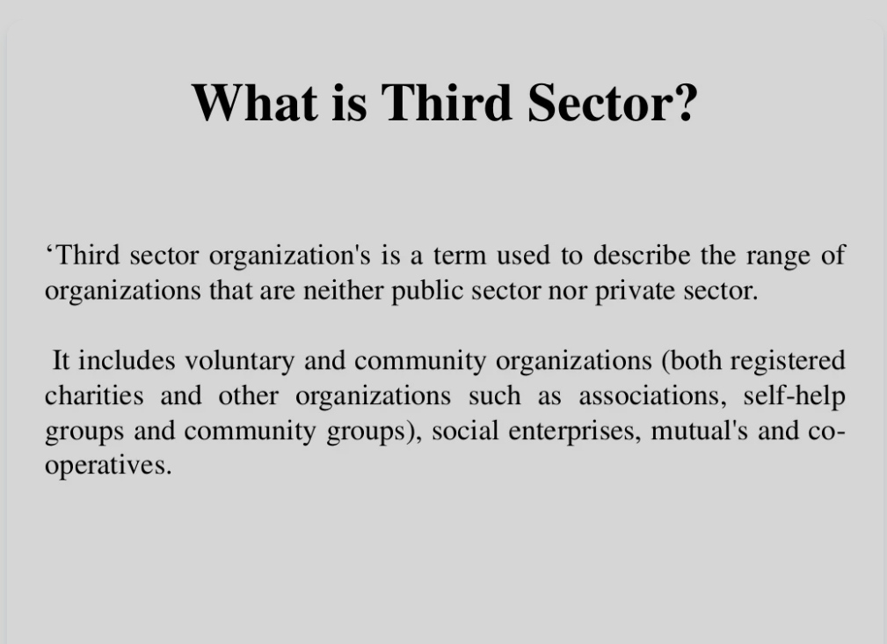

Slide 4
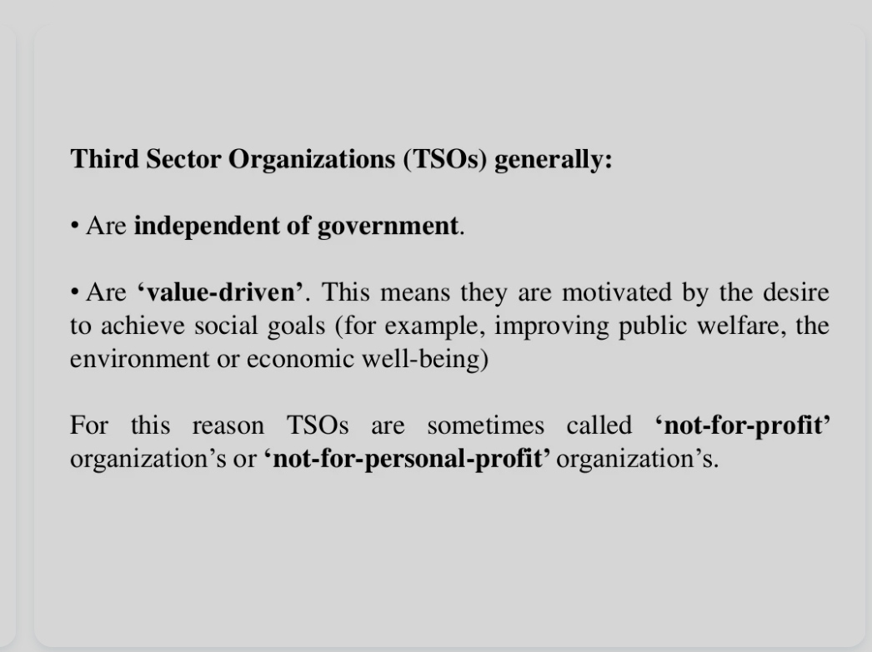

Slide 5
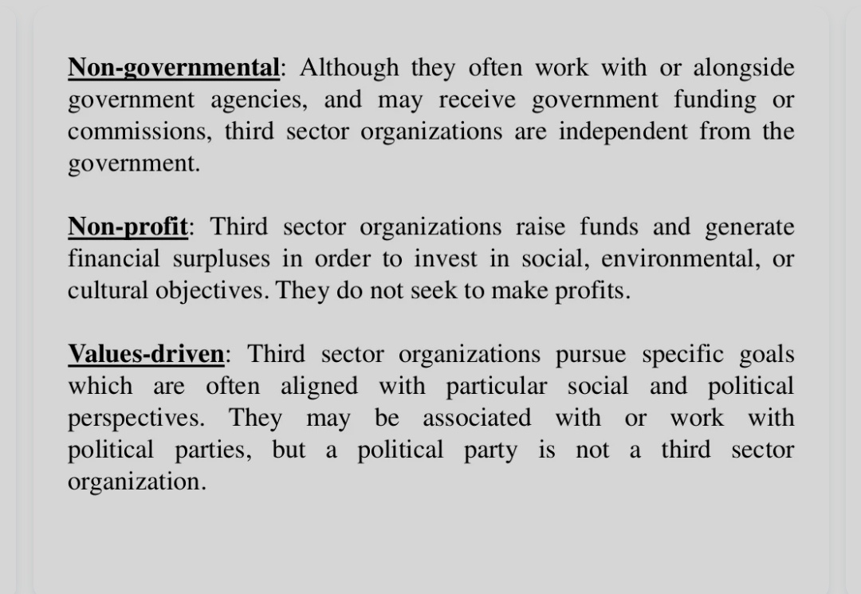

Slide 6


Slide 7
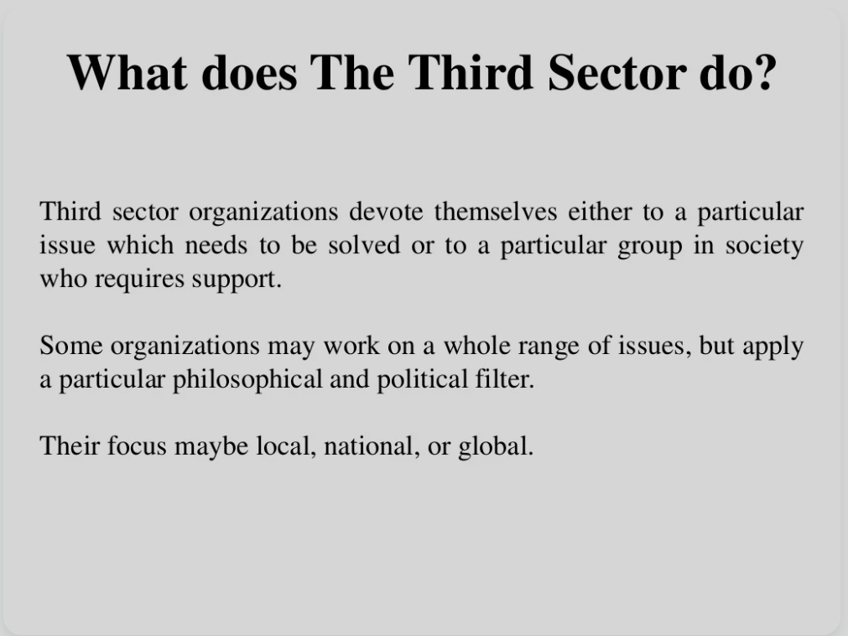

Slide 8
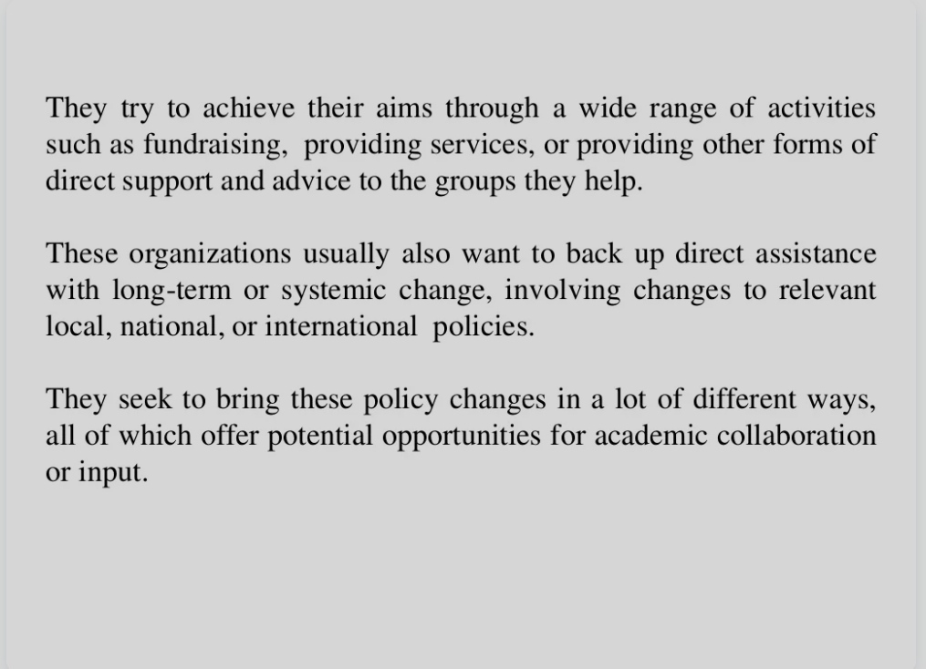

Slide 9
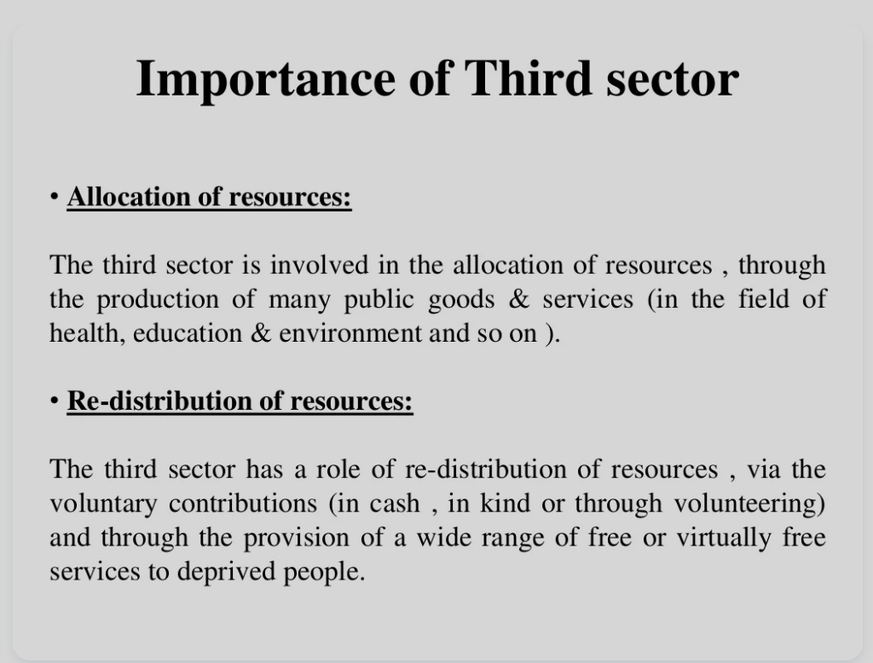

Slide 10
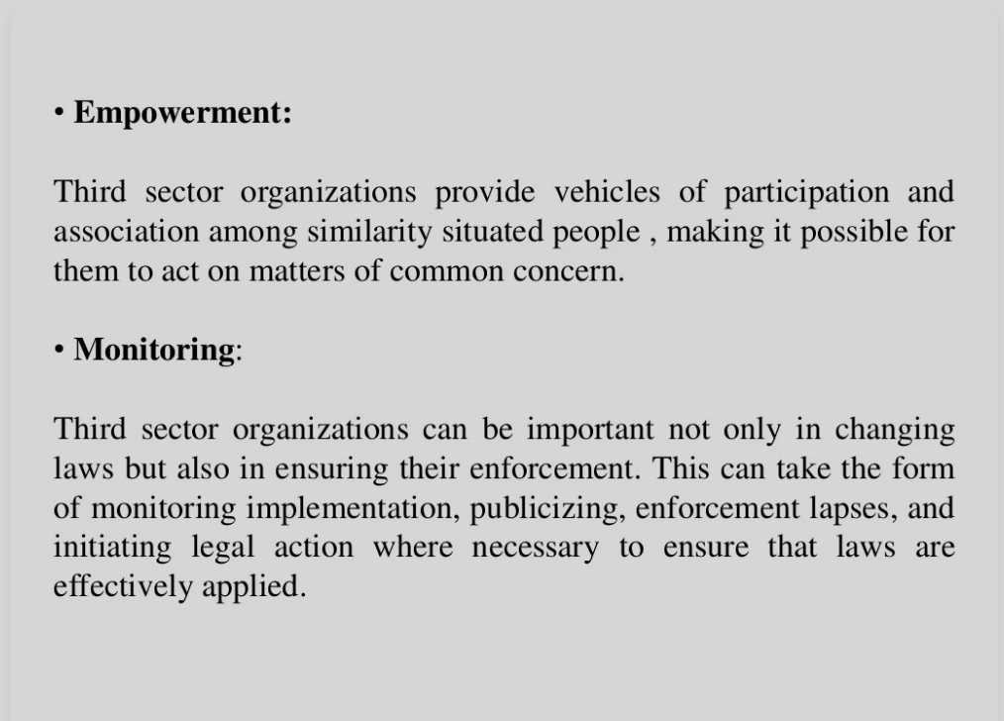

Slide 11
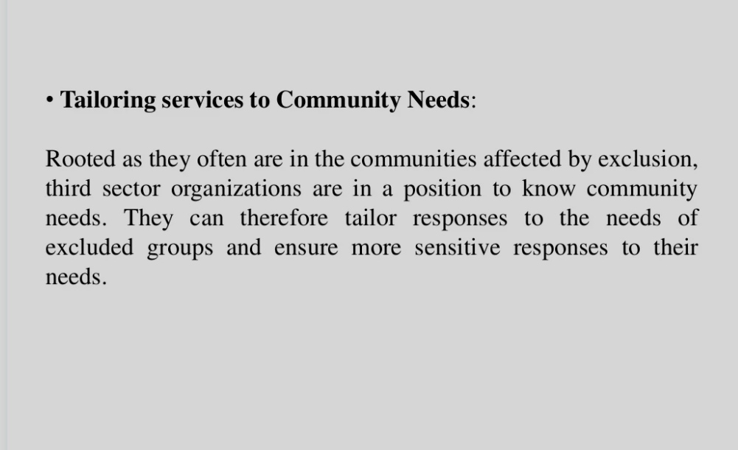

Slide 12
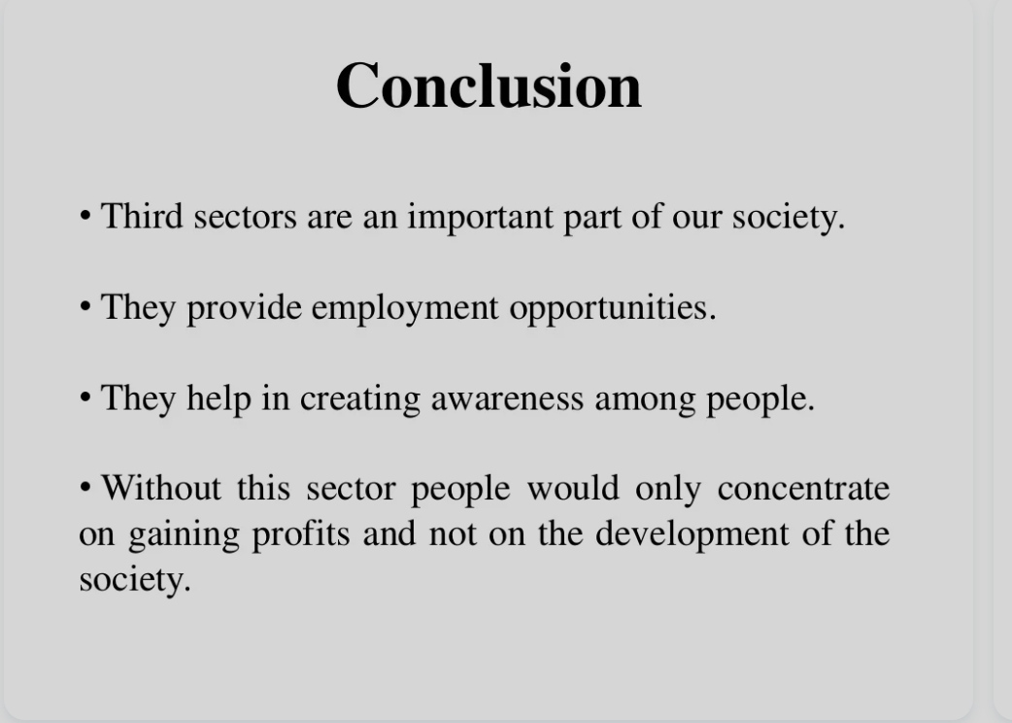

Slide 13
THANK YOU
- Reshma Jaleel
20MSW035

